Slide 1
Chinese Standards: GB & YY

Slide 2
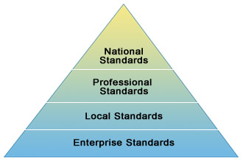
Different types of Standards in China
There are four levels of Chinese standards. The most widely implemented are the:
National Standards
Professional Standards
Local Standards
Enterprise Standards
These levels are hierarchical, so that Local Standards supersede Enterprise Standards, Professional Standards supersede Local Standards, etc. For any given product or service, only one type of Chinese standard will apply.

Slide 3
Classification of GB and YY
Standards
National Standards
GB
Professional Standards
YY(medical)

Slide 4
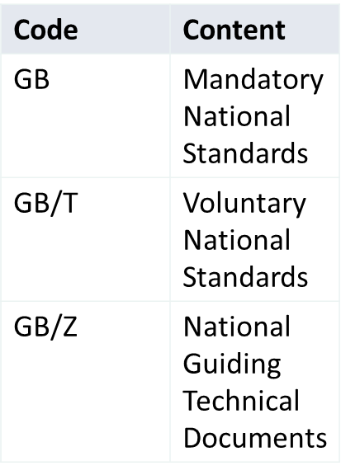

GB standards and YY standards
1
GB standards
YY standards
National Standards are often referred to as “GB standards”. They are consistent across all of China and are developed for technical requirements.
Many Chinese national GB standards are adoptions from ISO, IEC or other international standards developers. (As of 2006, nearly half of all Chinese national GB standards were adoptions of international standards and “advanced foreign standards”.)
Used for all purposes like labelling, product safety, lab testing, usage, etc.
Professional Standards are often referred to as “Industry Standards”.
They are developed and applied when no National GB Standard exists, but where a unified technical requirement is needed for a specific industry sector in China.
Professional standards are coded by industry sector. The codes of mandatory standards are shown in the following table, and the codes of voluntary standards have "/T" added after the mandatory codes.

Slide 5
FAQs
Who manages GB standards?
AQSIQ(managed under SAC)
Others: CNIS(China National Institute of Standardization),SPA(Standards press of china),CAS(China association of Standardization)
Do I need to have a CCC mark if my products have GB-standards?
No, you don’t necessarily need a CCC mark just because there are GB-standards for your products, but products that need CCC certification (listed in the Catalogue of Products subject to Compulsory Certification) must be tested in designated Chinese labs.
What happens if my products don’t meet the GB standards needed?
If the Chinese customs or CIQ discover that your products don’t meet the GB standards needed, you won’t be able to clear the customs.
The products will in such a scenario be kept by the customs or the CIQ and eventually be sent back.
Again, this results in time losses and costs that can, in a worst-case scenario, result in poor customer feedback and reduced sales.

